Slide 1
Evaluation and CSCW

Slide 2
Productivity paradox…
Does email make you more productive? How would you measure that?
https://www.interaction-design.org/encyclopedia/cscw_computer_supported_cooperative_work.html
Notes:
Companies try to show the values of things but can’t, e.g., email, does it make us more productive? If we can’t prove, it should we stop using it (productivity paradox) But see McGrath’s framework

Slide 3
Research strategy
In CSCW, always involves: somebody doing something, in some situation
Who, what, where
  Actors: human systems – individuals, groups, organizations, communities
  Behavior: all aspects of the states and actions of those human systems
  Context: temporal, locational and situational features in which the human system is embedded
Notes:
This gives you a framework! Seems obvious but trust me I’ve reviewed papers and student theses where I couldn’t identify these! Context is often missing!

Slide 4
Reference (see GitHub):
Evaluating Computer-Supported Cooperative Work:
Models and Frameworks
by Neale, Carroll and Rosson

Slide 5
Challenges of remote evaluation
Logistics in carrying out evaluations
Greater number of variables to consider
Need to validate reengineered work based on CSCW concepts
Performance measures rarely good indicators for evaluating CSCW systems
  But just looking at qualitative aspects isn’t the way to go either
Notes:
When, where and how to collect data – need multiple evaluators for distributed interaction
Need to consider individual cognitive factors as well as cooperative, collaborative aspects, as well as social and organization impact
Difficult to translate findings into system design
The system alters the group work; iterations of requirements, design and test takes longer than single user systems
Too much focus has been on disciplinary preferences in terms of evaluation rather than use of frameworks which guide towards which questions get asked and which factors should be considered in the landscape of study

Slide 6
Long term activities and teams
Long term activities are usually goal oriented
Need to consider support for communication, planning, coordination of tasks, monitoring project progress, cooperation and replanning
Need to establish support for ongoing awareness of all of these aspects
Notes:
e.g. research infrastructure committee work at uvic.
Need to consider sequential and longitudinal aspects

Slide 7
Groups vs Teams
Groups have task structures with limited role differentiation, performance depends on individual efforts
Teams have members with specialized roles, work together to accomplish common goals
Evaluation is more complex for teams than for groups – aggregation of factors must be considered
Notes:
Have both groups and teams in collaborative learning environments.
Arbitrary definitions I suppose! But good to define what is meant by these two terms.
In open source trying to determine roles from looking at their interactions – harder than you might think.

Slide 8
CSCW Evaluation - Reflections
Workplace studies have been mostly associated with qualitative work and ethnographic studies
Lab studies are largely seen as ineffective for evaluating CSCW
But both paradigms of quantitative and qualitative approaches may have benefits depending on your questions
Notes:
Can you think of some examples?
One example could be use of visualization construction… constrain how the experts work in a lab setting, but need to look at what really happens in practice too.
An aside personally I don’t like to refer to them as the quantitative and qualitative paradigms – too focused on the type of data collected rather than the underlying perspective of what is acceptable to you as “truth”.

Slide 9
Levels of analysis in CSCW
Need to consider individual, group, and organizational levels of analysis
Theory plays an important role in which research methods are used
But long term use is also critical, over months, years and even decades
Need to consider which methods will work over a long period of time
Notes:
A bit repetitive from what I’ve said so far, I know….

Slide 10
“Activity Awareness”
Core challenge in CSCW!
Different types of awareness:
  Social awareness
  Presence awareness
  Action awareness
  Workspace awareness
  Situation awareness
To understand the role of activity awareness, these authors propose a new model of awareness evaluation…
Notes:
Awareness is a core concept in CSCW, and the lack of awareness is one of the key reasons why many systems fail (and accidents or misunderstandings occur)
In remote work, Need to maintain awareness of coworkers, their tools and resources, their knowledge and expectations, their persistent attitudes and goals, and the criteria they use to evaluate joint outcomes, and the current focus of their attention and action.

Slide 11
Awareness evaluation model
Focused towards distributed applications
Purpose is to indicate the important variables and relationships among them to consider during evaluation
Understanding the variables and their relationships helps identify a starting point!

Slide 12
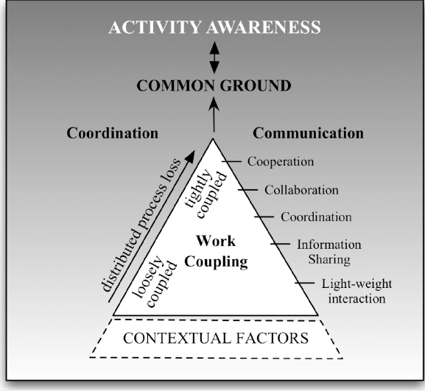
Notes:
(print this also and pass out to students to review during discussion of next slides)
Coordination appears twice, this always throws me.

Slide 13
Contextual Factors
Unit of analysis shifts from human action to comprehensive activities
Activities are ongoing, span across people, locations and time – thus need to understand contextual factors which underlie all collaborative activities and shape how the work is structured
Unfortunately distributed systems often elide the contextual factors – thus leading to surprise breakdowns
Notes:
Sabbatical case – may not realize that people can and do negotiate on this… not at all clear. It is not perfectly aligned, and the system as a whole benefits that it isn’t.

Slide 14
Work coupling and communication
Work coupling refers to the amount of information sharing and communication needed to meet the demands of work
Note that the granularity of dependencies between group members varies

Slide 15
5 Levels of Work coupling
Lightweight interactions – leading to communication about people’s lives and work situations
Information sharing – bi or unidirectional – helps with understanding of what is going on
Coordination – requires both activities and communication to be coordinated
Collaboration – involves members moving towards a common goal
Cooperation – shared goals, common plans, shared tasks, significant consultations
Notes:
5. Requires highest amount of high quality communication – team priorities are more important than individual priorities.
Coordination, collaboration and cooperation leads to another aspect of Team Coordination…

Slide 16
Team Coordination
Coordination can be characterized by processes, procedures, tasks, tools and awareness
Again time is a key concept – sequence of events and timing dependencies need to be considered
Shared artifacts may be important coordination devices
But coordination can be viewed as overhead
The more awareness there is, the less need for coordination – joint awareness is their “common ground”
Notes:
Looking at coordination at a macro level…
Specific procedures need to be in place.
For example Brooks talks about the n^2 effect as the n gets larger in a software development team
(2 days – multiple it by 2, change unit to weeks) metric used in software development teams

Slide 17
Common Ground
Joint awareness that people share is their common ground
It is the knowledge that each believes the other shares in common with them
There is a need to continually update their common ground – this is called “grounding” – a joint effort on the part of both people
Awareness is both a product and a process
The amount of context group members share makes a big difference in the quality of their common ground
Notes:
Already talked about this in the distance matters paper so shoul

Slide 18
Collaboration success wizard
See Judith Olson’s talk: https://www.youtube.com/watch?v=GlHd5GsXpJ8

